Slide 1

Politecnico di Milano
A.A. 2015-2016
Software Engineering 2 project: MyTaxiService
Design Document
Alessandro Pozzi (matr. 852358)
Marco Romani (matr. 852361)

Slide 2
Problem overview
Different users communicating over the internet with a single system
Client-Server three-tier Architecture
Users can use different platforms (mobile and web)
The system accepts user’s requests and elaborate an answer in a short time
Event-based architecture with Publisher-Subscribe
The system must notify multiple users when some events occur

Slide 3
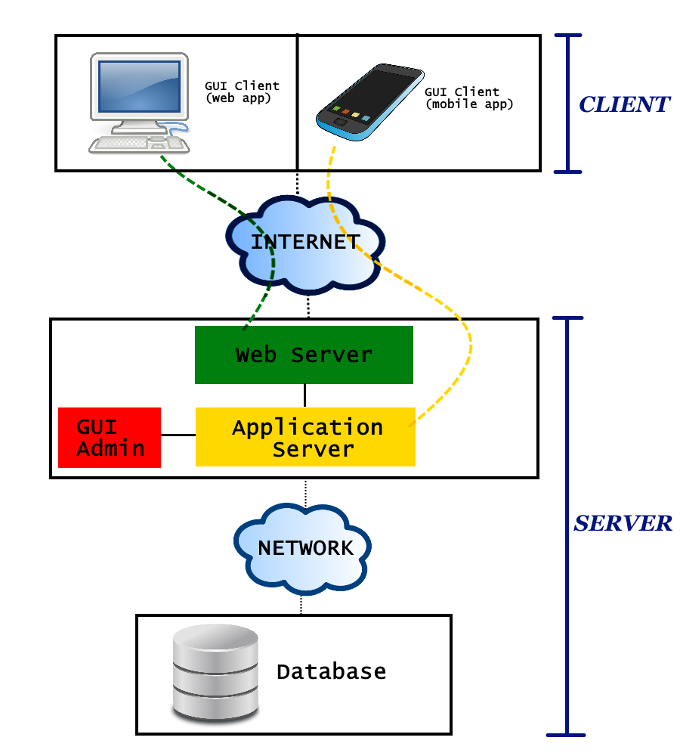
Three tier architecture
Top tier (Client)
The users’ machines (mobile phones and computers) will have the only purpose to load the Graphical User Interface (GUI)
No application logic is involved at this level
Clients will only be able to send requests to the web server and application server.

Slide 4
Three tier architecture
Middle tier
Web Server
Manages the web requests sent by clients using the web application.
If the request can be resolved with a static content page, the web server will generate and send the response itself.
If the request comports a dynamic content, the web server will delegate the dynamic response generation to the application server

Slide 5
Three tier architecture
Middle tier
Application Server
Provides access to the business logic
Provide lightweight APIs to be used directly by mobile application clients
Web application clients will access this component indirectly, through the Web Server.
Admin’s GUI
Specific interface for Administrators
Allows Admins to access to their exclusive functions dialoguing directly with the business logic

Slide 6
Three tier architecture
Bottom tier (Database)
Separated from the previous one with a (possibly local) network
Contains all the data that MyTaxiService needs to store

Slide 7
Event-based architecture
The core of MTS’s application logic is event-based:
Significant change of state (users modifying theirs account information, drivers changing status, etc)
Event
The system will handle it accordingly
Generates
In particular, the managing of the customer’s requests and taxi rides will be modeled with the publisher-subscribe pattern.

Slide 8
Publish-Subscribe pattern
CUSTOMER
TAXI RIDE
TAXI DRIVER
Asks for
Accepts the ride request and gets associated to the ride
The system generates
TOPIC
The customer is automatically subscribed to the topic and can receive its notifications
The driver is subscribed to the same topic too

Slide 9
Publish-Subscribe pattern
A logical component of the system that creates a publication on a topic when something relevant happens
Publisher
BROKER
An intermediary component that performs the queue management and the filtering of the messages
Filter messages based on their content, so that taxi drivers and customers related to the same topic won’t receive necessary the same notification or message
Subscribers
Messages are delivered to the subscribers (taxi drivers and customers)

Slide 10
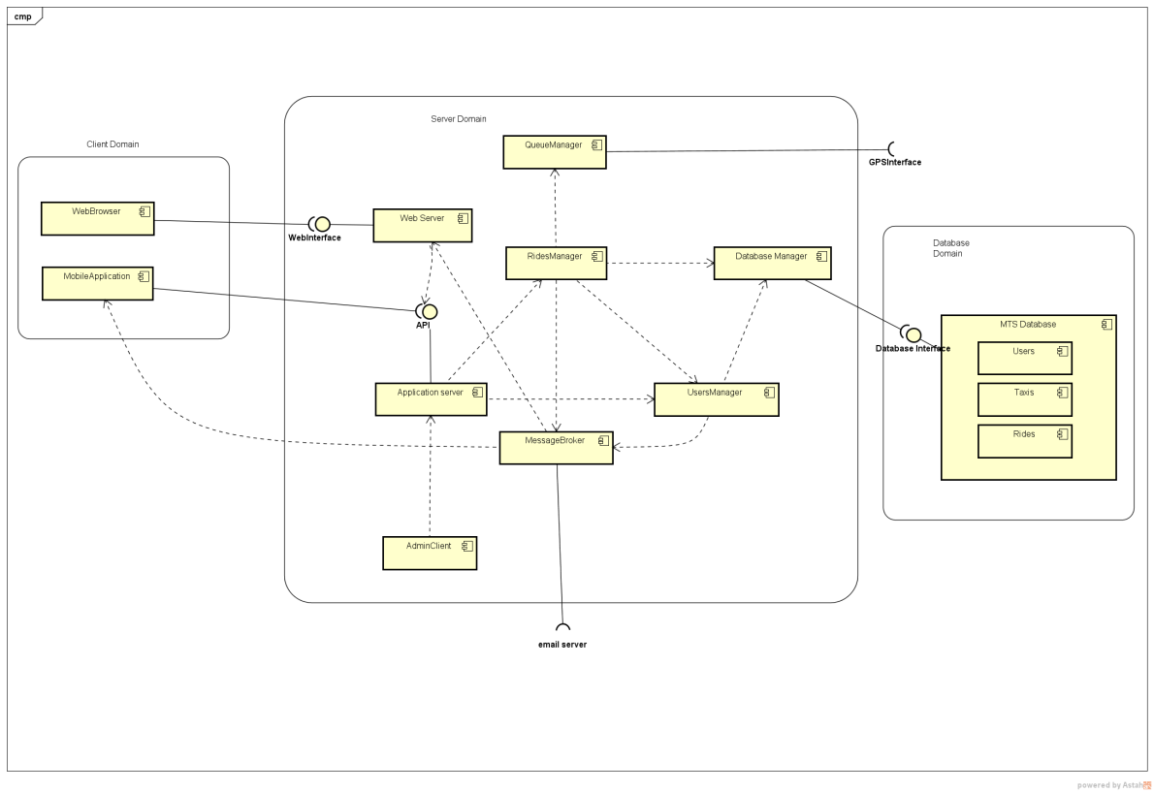
Components

Slide 11
Components
WebServer: This component represents the front-end of the system that interacts with the web application’s users. Can answer their requests with a static content page and dialog, if needed, with the ApplicationServer.
ApplicationServer: Represents the front-end of the system that interacts with mobile application’s users and the Admin’s GUI. Can dialog with other internal logic components.
RidesManager: Handles requests and reservations and, in general, everything that is connected with rides. It is a central part of the application, and is the only component that interacts with the QueueManager.

Slide 12
Components
QueueManager: Manages the taxi zones and queues logic. It memorize (but does not store in the DB) the position of every active taxis received by the GPSInterface.
MessageBroker: Implements the Broker role in the publisher-subscribe pattern. Receives the publication messages from the RidesManager and UsersManager and forward the appropriate communications to the clients.
DataBaseManager: Handles the only access point of the middle tier to the DB tier.

Slide 13
Deployment
Now we need to map the components into real machines!

Slide 14
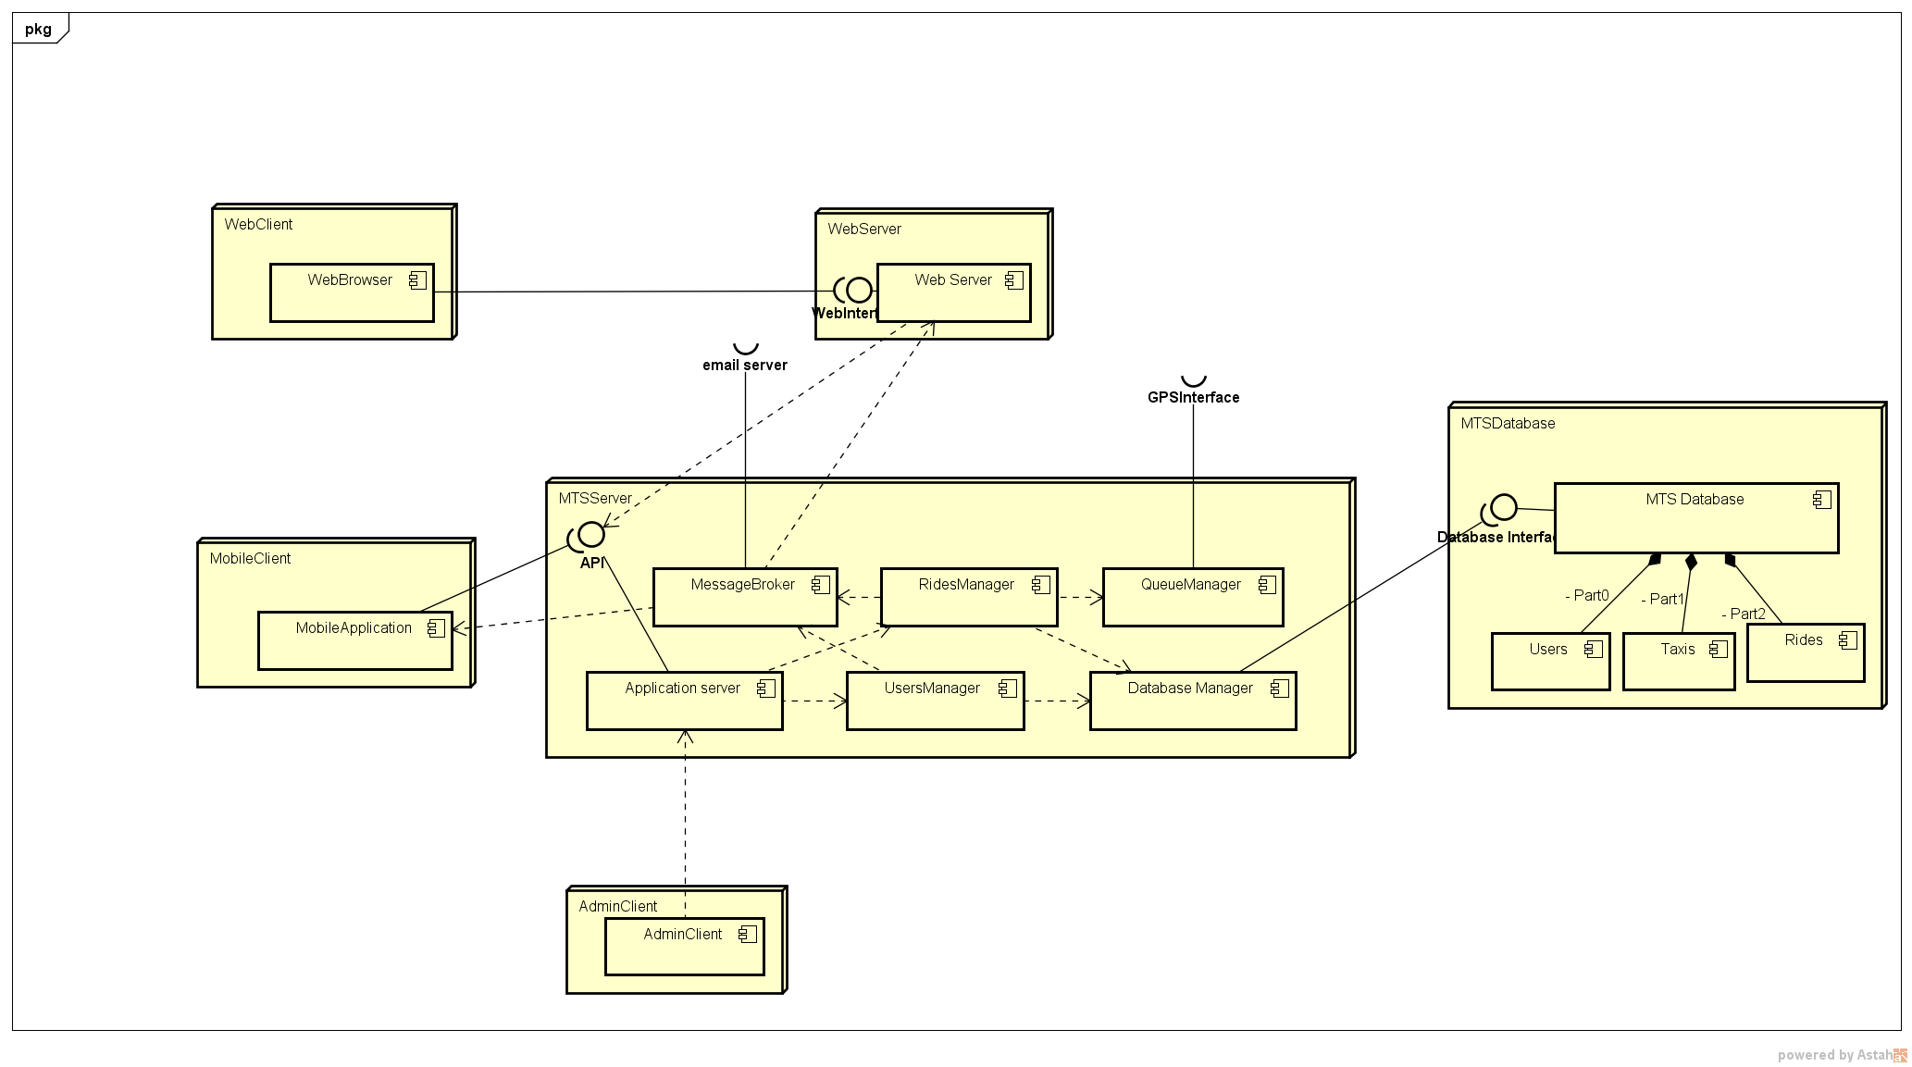
Deployment

Slide 15
Deployment
WebClient: Physical machine that runs the client’s browser. It could be for example the personal computer of a customer. This node is separated from the system by the Internet network.
MobileClient: Physical mobile device that runs the mobile version of the application, previously installed. It could be for example the smartphone of a customer. This node is separated from the system by the Internet network.
AdminClient: Physical machine used by administrators in order to access to their reserved functionalities. We think that it should be better to have these machines (there could be more than one) located within the same private network of the MTS Server to achieve a higher level of security.

Slide 16
Deployment
WebServer: This node contains the web server component, which is not located on the same machine of the actual MTS Server. However, our idea is that they should be located within the same private network, even if this is not mandatory.
MTSServer: This node contains all the business logic of the application and is the central part of the whole system. It is separated from the front end users by the Internet network and it’s the only node that is connected with the persistent data in the database.
MTSDatabase: Physical database in which all the persistent data of the application are stored. Also in this case we think that it should be better to have the database in the same private network of the other “server nodes”, both for security and performance concerns.

Slide 17
Components’ Interfaces
Let’s have a look at the interactions between the most interesting components:
What do they offer and what do they need?

Slide 18
Application Server
What it offers
What it needs
Registration of customers and login of registered users.
Operations concerning taxi rides, such as taxi requests, reservations and rides’ deletion.
Access to the rides’ history and past rides’ information.
Operations reserved to taxi drivers, such as availability and acceptance/refusal of a ride.
Operations reserved to administrators, such as create/delete accounts, modify rides/driver status.
Interfaces for the creation, deletion and management of taxi rides, and also for the associations between customers, drivers and rides.
Interfaces for the creation and management of users, as well as for validation of accesses.

Slide 19
Rides Manager
What it offers
What it needs
Creation of requests and reservations and the deletion of rides.
Termination of rides.
Subscription of customers and drivers to rides.
Retrieval of the rides history of a customer and info about specific rides.
Interfaces for taxi queue management.
Interfaces for the management of users.
Interfaces for the communications of messages/notifications.
Interfaces for the access to MTS database.

Slide 20
Users Manager
What it offers
What it needs
Creation and deletion of users.
Retrieval of users.
Validation check in case of login and registration
Availability setting in case of drivers.
Interfaces for the communications of messages/notifications.
Interfaces for the access to MTS database.

Slide 21
Queue Manager
What it offers
What it needs
Taxi retrieval and taxi removal from taxi queues.
Interfaces for moving a taxi at the bottom of a queue and in general for updating taxis’ position.
Taxis’ GPS coordinates’ retrieval.

Slide 22
Message Broker
What it offers
What it needs
Forwarding of messages filtered by topic.
Forwarding of messages filtered by user.
Interface for sending ‘’web messages’’.
Interface for sending messages directly to client applications.
Interface for sending emails.

Slide 23
Sequence - Reservation
Now let’s have a look to an example of runtime behaviour of the system.
The context chosen is a successfull taxi reservation, which is a quite relevant case and involves almost all the components.

Slide 24
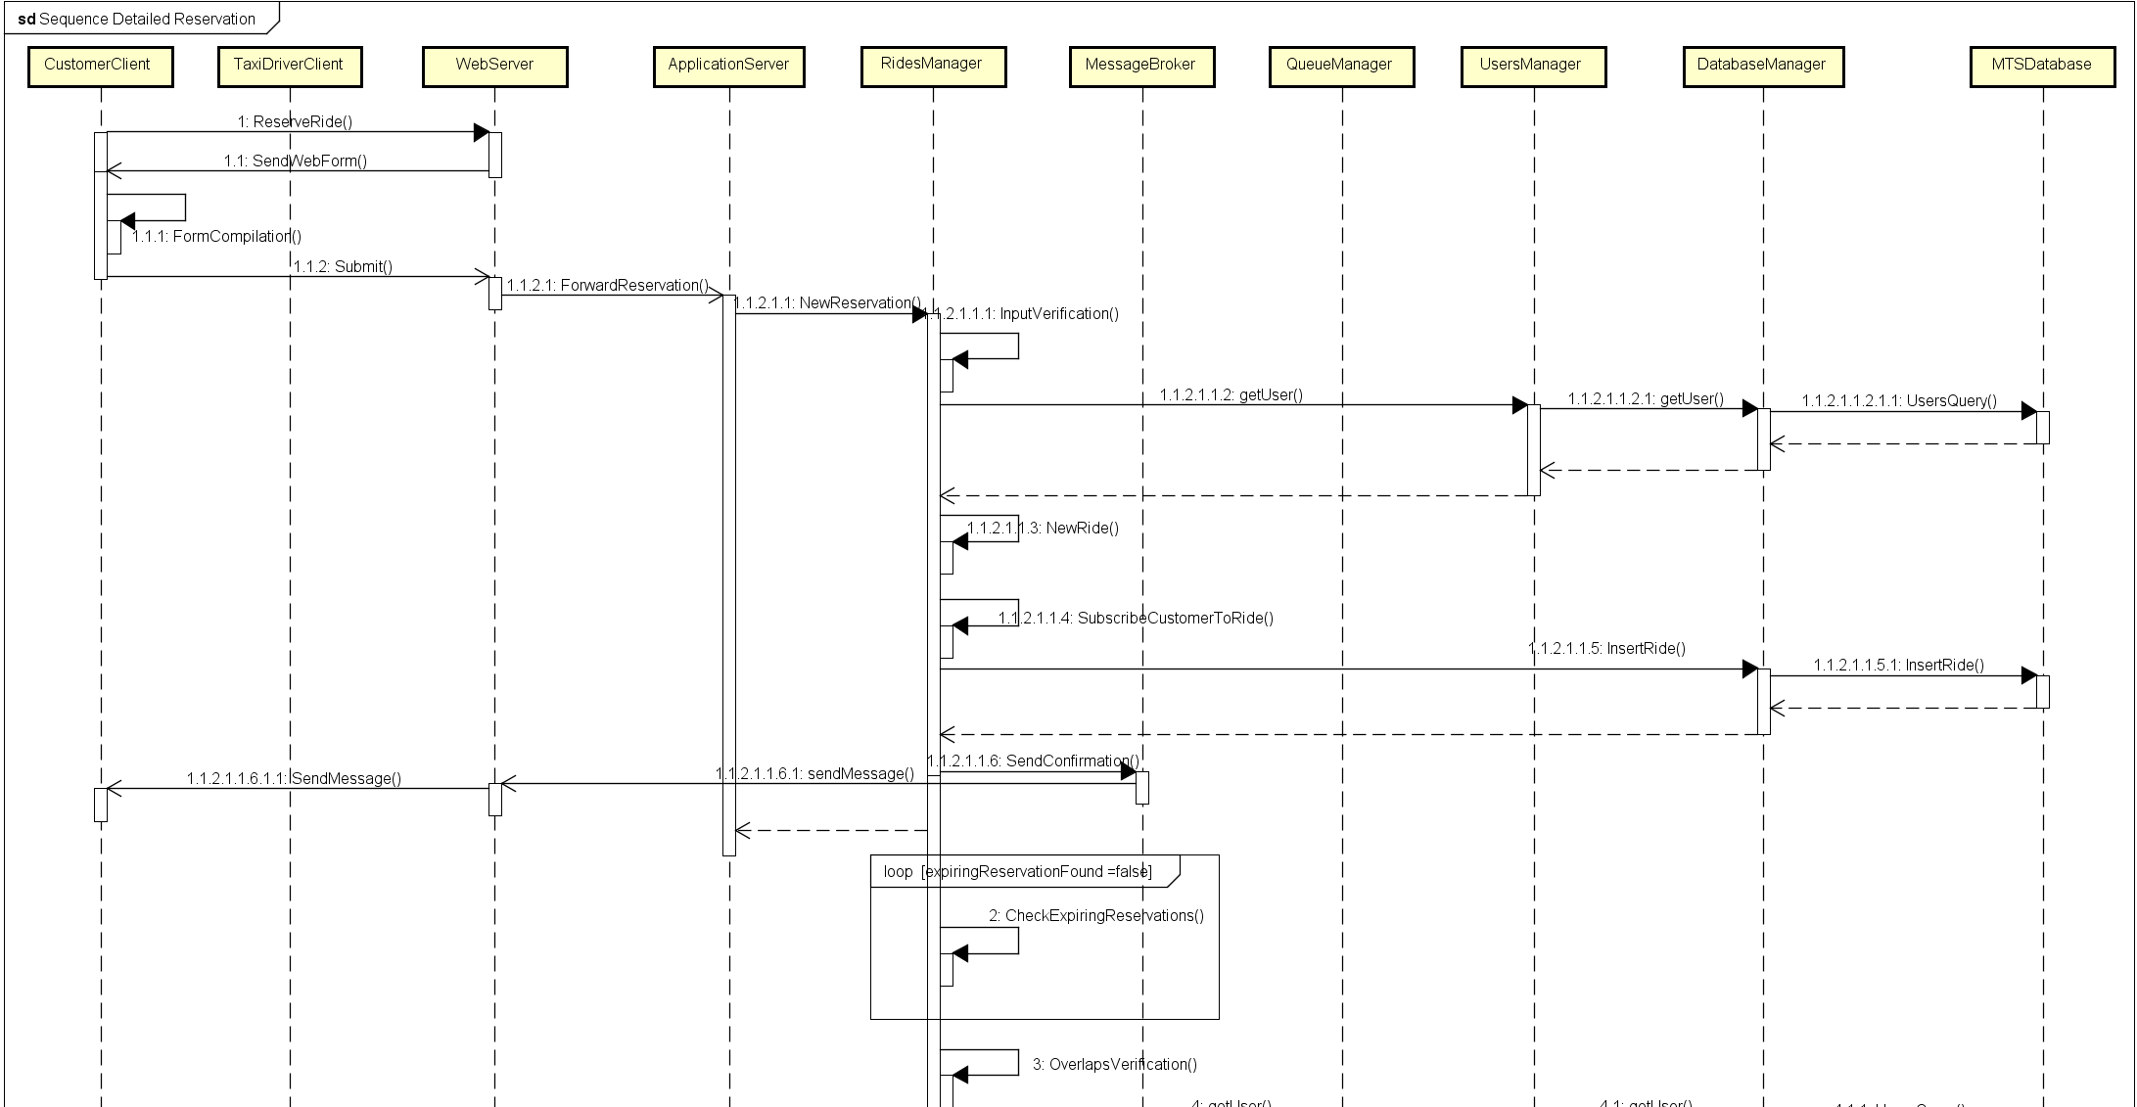
Sequence - Reservation

Slide 25
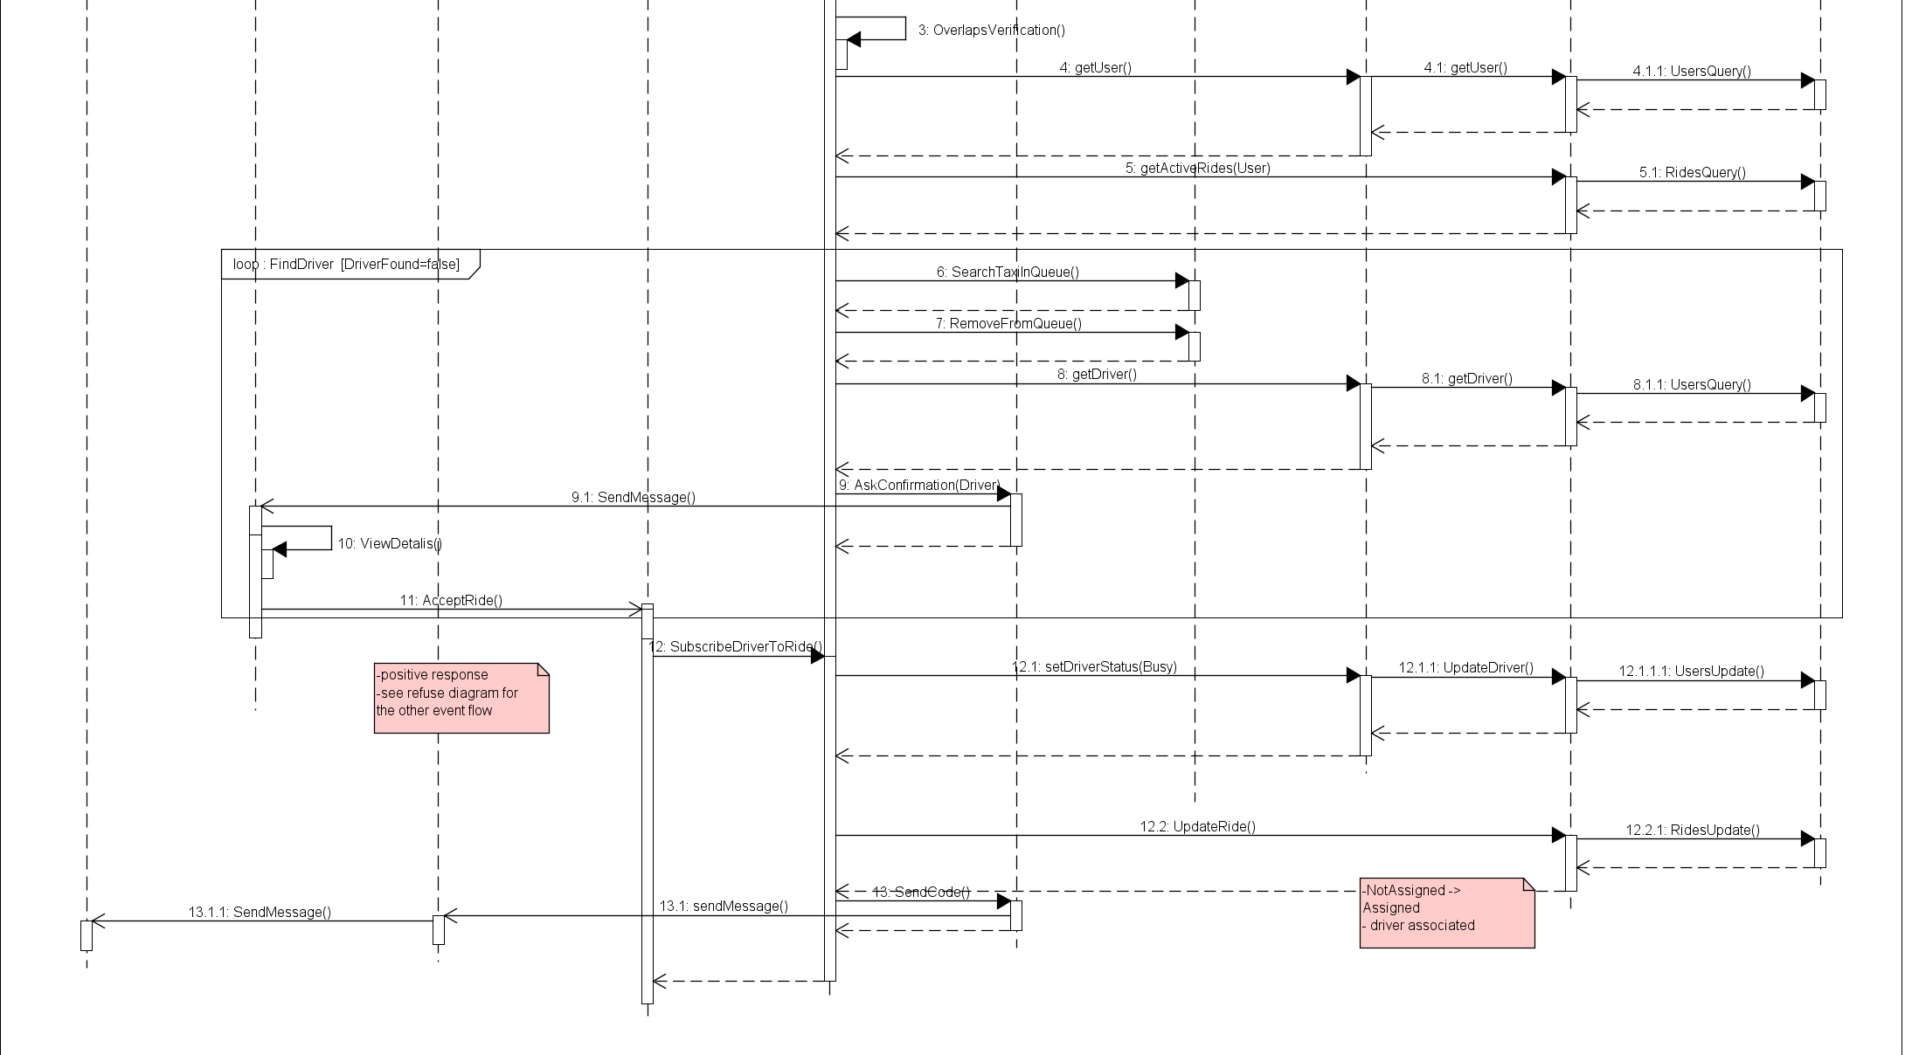
Sequence - Reservation

